Slide 1
Inquiry Project
Claire Hillard

Slide 2
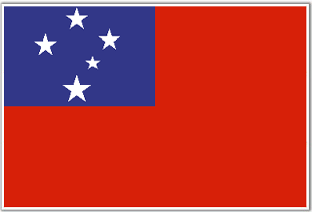
The Question:
How do the demographic characteristics of Samoa and Australia differ?

Slide 3
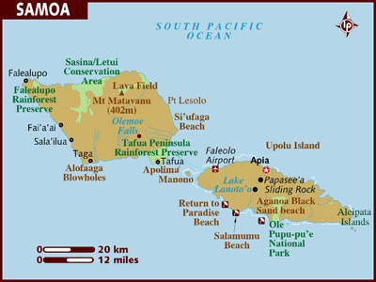
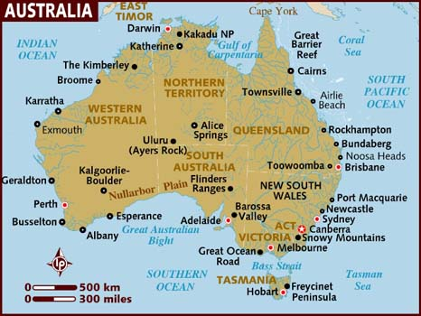
Why these places?
The reason that I chose these countries, over others, is because, I wanted to do places that were located in similar areas and had similar characteristics (ie. Both islands, similar location, etc.)

Slide 4
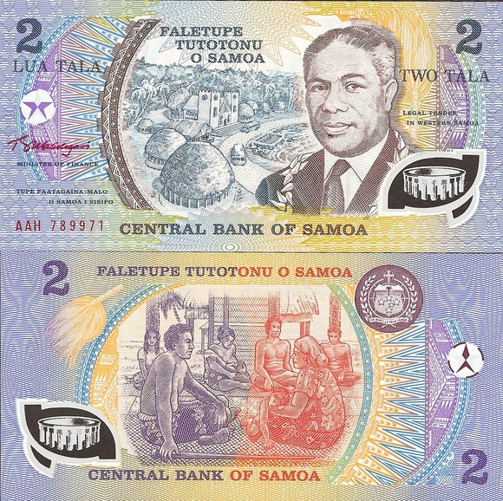
Samoa:
Location: Oceanic area: 14s 172w
Land Area: 2830sq km
Money: Tala: $1.00= 2.27 (about)
Population: 176,908 (as of 2006)
CDR: 6.62 Death/1000
CBR: 16.43 Birth/1000
IMR: 22.74 Death/ 1000 live births
Net Migration Rate: -11.76 migrants/1,000

Slide 5
Samoa: (Continued)
Main Religion: Christian (99%)
Languages: Samoan and English
Total Fertility Rate: 2.94 children/woman
Population:
0-14: 26.1%
15-64: 67%
65+: 6.6%

Slide 6
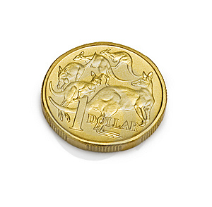
Australia:
Location: Oceanic Area: 32s 141 E
Land Area: 7,681,000 sq. km
Money: Australian Dollar: $1.04= $A1
Population: 22,890,192
CDR: 6.68 Death/1000
CBR: 12.47 Births/1000
IMR: 4.55 Death/1000
Net Migration: 5.93 Migrants/1000

Slide 7
Australia: Continued
Main Religion: No Main Religion
Languages: Mostly English, Other languages as well
Total Fertility Rate: 1.92 Children/woman
Population:
0-14: 19.3%
15-64: 67.5%
65+: 13.2%

Slide 8
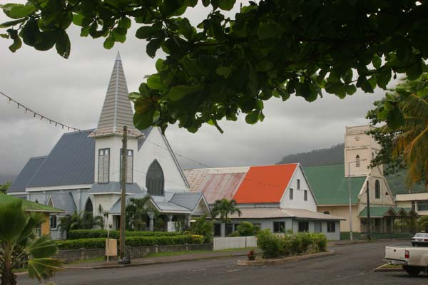
The Difference:
Australia
Samoa
As you can tell in these two photos Australia is much more developed then Samoa. Australia has large buildings and landscape, while Samoa is mostly small towns, and beautiful land.

Slide 9
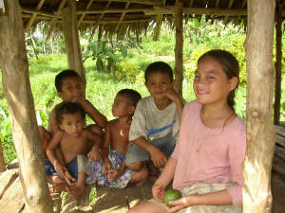
Comparing: Children
From looking at the data I collected I noticed that there was a lot of children in Samoa. The percentage of children in Samoa was higher then that in Australia.

Slide 10
The Answer:
The question I am answering is this: “How does the demographic characteristics of Samoa and Australia differ?” Australia, being a MDC, is much more advanced and has larger cities like ones in the US (also a MDC) But Samoa, is an LDC. The largest city is Apia and it only has 40,407 people. The towns are much smaller and there are very few large buildings. Samoa has more people moving out then moving in, though this isn’t a huge concern, because the CBR is so high and the CDR is low. Unlike most LDC’s Samoa doesn’t have a large death rate, but the average age that they die is 70 years old but Australia’s is about 80. The Differences in a MDC and an LDC are quite different and the ones that I chose aren’t as dramatic as some (very high death and sickness)

Slide 11
Reference Page
www.nationsonline.org
www.wikipedia.org
www.worldatlas.com
www.nationsencycolpedia.com

