Slide 1
The History of the Jerusalem Wars
A Time Line
By: Kelsay Cook, Claire Hillard, and Alexis Diaz

Slide 2
Topic Questions:
How and why did it start?
Who invaded Jerusalem?
Did anyone start the War? If so who?
Every time a new group of people invade into Jerusalem, what happens to the people who were already there?

Slide 3
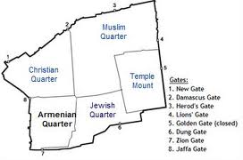
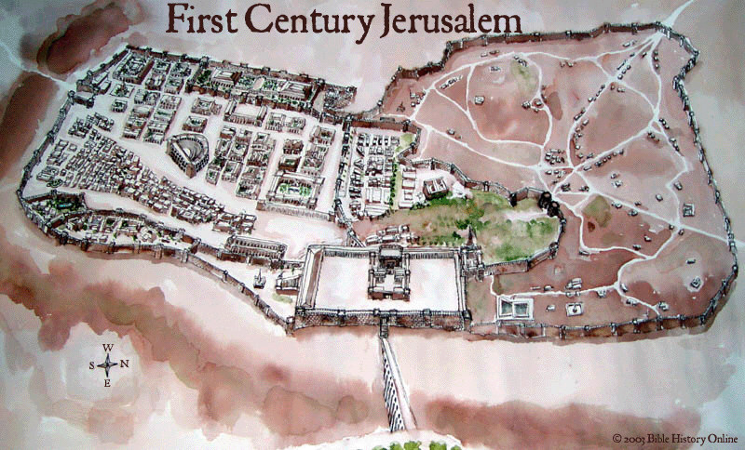
Background of Jerusalem
4 regions (at least in 1996) 1) Christian Quarter 2) Muslim Quarter 3)Armenian Quarter 4) Jewish Quarter
4 main religions 1)Jewism 2)Christian 3)Abrahamic religions 4)Muslim

Slide 4
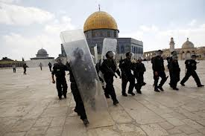
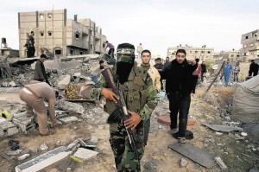
Little background of battles
Jerusalem was destroyed twice
Besieged 23 times
Attacked 52 times
Was a target of the Crusades
A common occurrence was when new people came to Jerusalem, the Jews were either kicked out or worse.

Slide 5
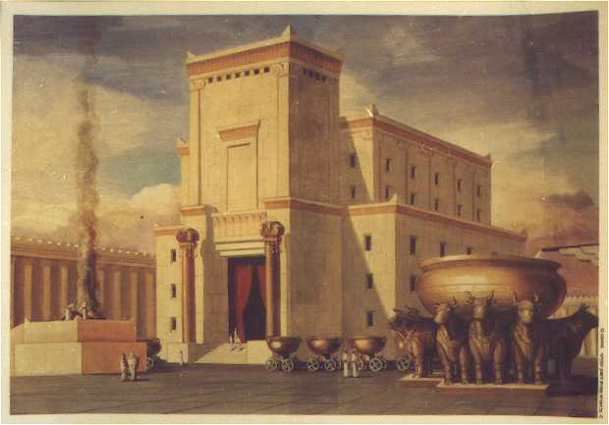
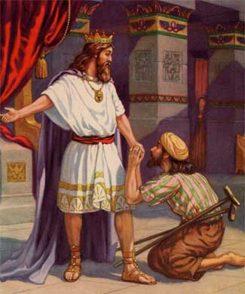
The BCE’s (before common era)
1738- The first Jews go to Jerusalem
866- King David, made Jerusalem the capital of Israel
825- First Jewish temple was built
423- Babylonians destroyed temple and exiled Jews
Solomon’s Temple
(known as first temple)
King David

Slide 6
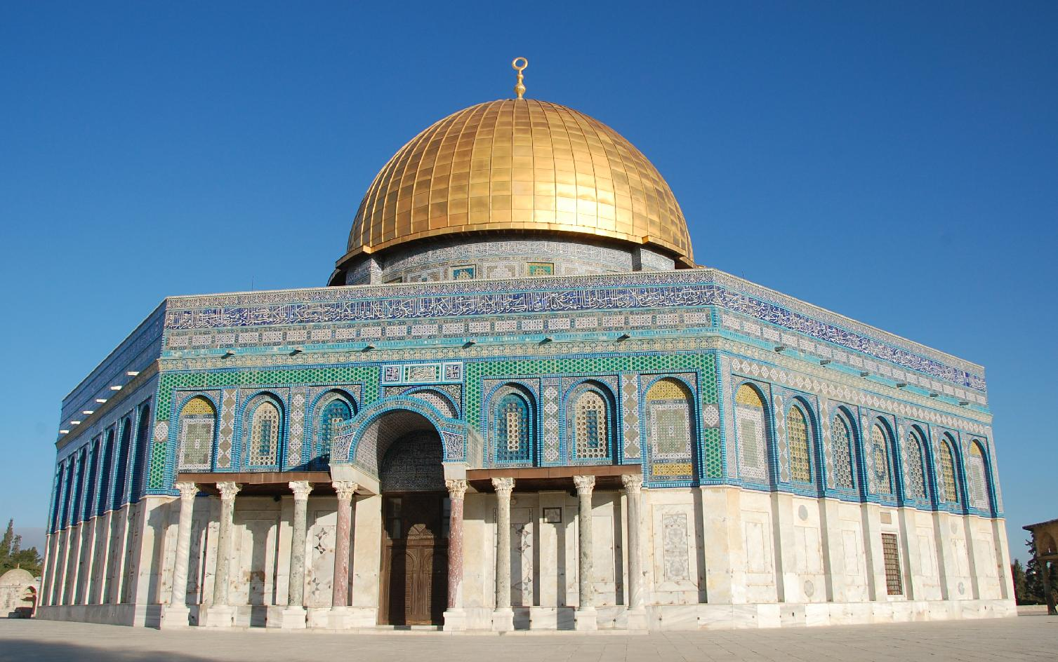
CE (Common Era)
638: Muslims conquer Jerusalem, they allowed Jews back. They built Mosques on Temple Mount
1099: Christians defeat Muslims and take over Jerusalem. They kill all of the Jews in Jerusalem
1517: Turks then conquer over Jerusalem

Slide 7
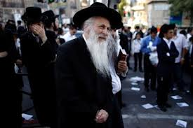
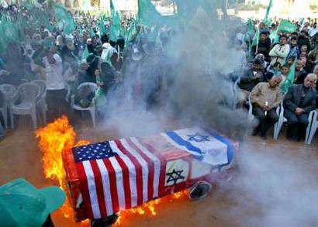
The CE (continued)
1850: Jews began to return to Jerusalem
1917: The British conquer Jerusalem, this was near the end of WWI.
1948: Jordanians Conquer Jerusalem. All Jews in Jerusalem were either killed or driven out.

Slide 8
Overall Summary
There were many conflicts that could have started the wars, however, there is not one prominent one.
There are many regions and religions that have attacked Jerusalem to claim it as their own. Since the beginning of when Jerusalem was first established, it has been invaded and besieged.

Slide 9
Reference Page
www.wikipedia.org/wiki/kingdom
www.simpletoremember.com

